Slide 1
VCF Operations Policies

Slide 2
Importance
VCF Operations policies help to analyze and display information about the objects in your environment. These policies enable you to create and manage policies for various aspects, including security, sampling, and pricing, to optimize your IT operations and ensure compliance.

Slide 3
VCF Operations Policies

Slide 4
Learner Objectives
Use policies to analyze information about various object types and objects in your environment
Configure policies and other components
Perform the importing and exporting of content

Slide 5
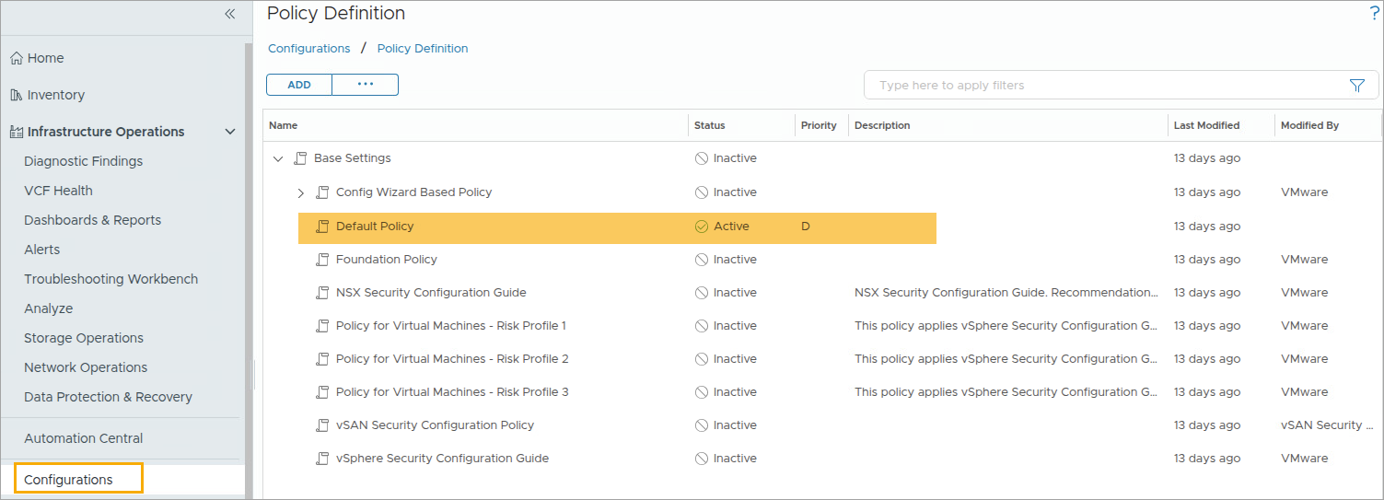
About Policies
A policy is a set of rules that you define for VCF Operations to analyze and display information about the objects in your Private Cloud environment.
A policy includes the following settings:
Metrics or properties for object types such as VM, host, or data store
Symptom and alert definitions
Threshold definitions for factors such as workload, time remaining, and capacity remaining
Notes:
TalkTrack:
A policy is a set of rules defined for VCF Operations to analyze and display information about objects in a Private Cloud environment. A policy includes metrics or properties for object types such as virtual machines, hosts, or datastores. It also includes symptom and alert definitions. Threshold definitions for factors such as workload, time remaining, and capacity remaining are part of a policy. VCF Operations administrators assign policies to object groups and applications to support service-level agreements (SLAs) and business priorities. When using policies with object groups, ensuring that rules defined in the policies are effective for the objects in the environment is important. Each policy can inherit settings from other policies. Customization and override analysis settings, alert definitions, and symptom definitions for specific object types are possible to support SLAs and business priorities for an environment.
<End>
VCF Operations administrators assign policies to object groups and applications to support service-level agreements (SLAs) and business priorities. When you use policies with object groups, ensure that the rules defined in the policies are effective for the objects in your environment.
Each policy can inherit settings from the other policies. You can customize and override analysis settings, alert definitions, and symptom definitions for specific object types to support the SLAs and business priorities for your environment.

Slide 6
Relating Policies and Environment
VCF Operations policies support the operational decisions for your IT infrastructure and business units:
With policies, you control the data that VCF Operations collects and reports for specific objects in your Private Cloud environment.
When you manage policies, you must understand the operational priorities for your Private Cloud environment and tolerances for alerts and symptoms to meet the requirements for your business-critical applications.
VCF Operations applies the policies in the priority order.
Notes:
TalkTrack:
VCF Operations policies support the operational decisions for IT infrastructure and business units. With policies, the data VCF Operations collects and reports for specific objects in a Private Cloud environment is controlled. When managing policies, understanding the operational priorities for a Private Cloud environment and tolerances for alerts and symptoms is crucial to meet the requirements for business critical applications. VCF Operations applies policies in priority order. To implement capacity policy settings, comprehending the environment's specific requirements and tolerances, such as for CPU utilization, is necessary. Object groups and policies can be configured to match the Private Cloud environment. For production environments, configure higher performance settings and account for peak usage periods. For test environments, higher usage settings can be configured. When defining policy priorities, VCF Operations applies the configured settings based on the policy rank order. This determines how objects are analyzed and reported.
<End>
To implement capacity policy settings, you must understand the requirements and tolerances for your environment, such as CPU use.
You can configure object groups and policies according to your Private Cloud environment:
For a production environment policy, configure higher performance settings and account for peak use times.
For a test environment policy, configure higher use settings.
When you establish the priority for your policies, VCF Operations applies the configured settings in the policies according to the policy rank order to analyze and report your objects.

Slide 7
Designing Policies
Implementing policy decisions in VCF Operations is typically the responsibility of the Infrastructure Administrator or the Virtual Infrastructure Administrator, but users who have privileges can also create and modify policies.
You must be aware of the policies established to analyze and monitor the resources in your Private Cloud IT infrastructure:
If you are a Network Operations engineer, you must understand how policies impact the data that VCF Operations reports on objects and which policies assigned to those objects trigger alerts and issues.
If you are the person whose role is to recommend an initial setup for policies, you typically edit and configure the policies in VCF Operations.
If your primary role is to assess problems that occur in your environment, but you do not have the responsibility to change the policies, you must still understand how the policies applied to objects affect the data that appears in VCF Operations. For example, you might need to know which policies apply to objects that are associated with particular alerts.
If you are a typical application user who receives reports from VCF Operations, you must have a high-level understanding of the operational policies so that you can understand the reported data values.
Notes:
TalkTrack:
Implementing policy decisions in VCF Operations is typically the responsibility of the Infrastructure Administrator or Virtual Infrastructure Administrator. Users with privileges can also create and modify policies. Awareness of the policies established to analyze and monitor resources in a Private Cloud IT infrastructure is crucial. If acting as a Network Operations engineer, it is important to understand how policies affect the data VCF Operations reports on objects. Knowledge of which policies assigned to those objects trigger alerts and issues is also necessary. If tasked with setting up policies, typical duties include editing and configuring them within VCF Operations. If the primary role involves assessing problems in the environment, without the responsibility to change policies, it is still essential to comprehend how policies affect the data displayed in VCF Operations. For example, understanding which policies apply to objects associated with particular alerts is key. If a typical application user receives reports from VCF Operations, a high-level understanding of the operational policies is needed to interpret the reported data values.
<End>
For more information, refer to the Policies section in the VCF 9.0 documentation: https://techdocs.broadcom.com/us/en/vmware-cis/vcf/vcf-9-0-and-later/9-0/infrastructure-operations/configuring-policies/managing-and-administering-policies/policy-decisions-and-objectives.html

Slide 8
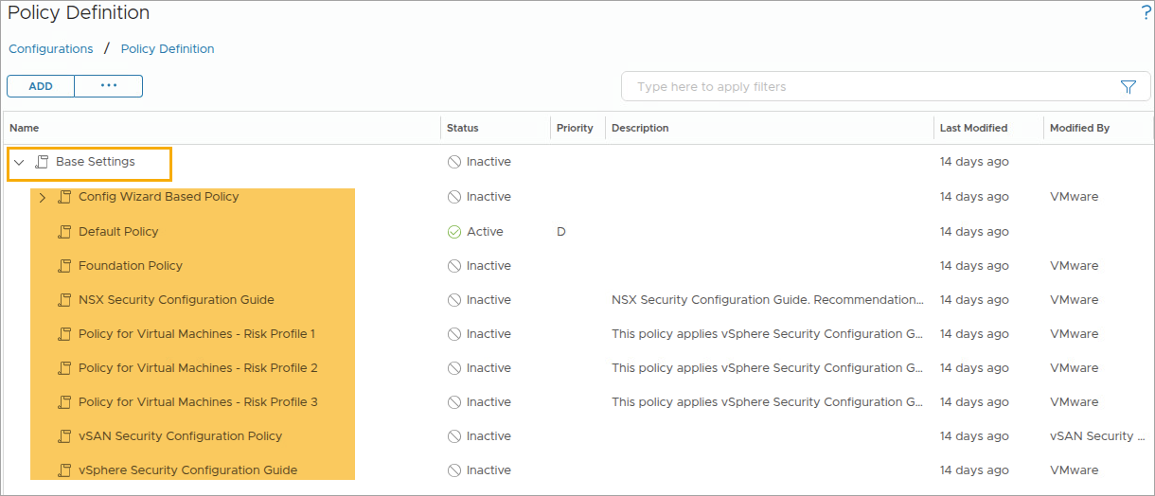
About Base Settings
The Base Settings policy is the starting point for all policies. All policies are derived from base settings.
Notes:
TalkTrack:
Base settings are the starting point for all policies; all other policies are derived from these base settings. The Base Settings policy acts as an umbrella for all other policies. This policy is at the top of the policy list in the policy library. All other policies are under Base Settings. Data adapters and solutions installed in VCF Operations provide a collective group of base settings that apply to objects. Built-in policies listed in the policy library represent best practice policies. These can be used to create custom policies. The policy library includes all configurable settings for policy elements such as workload, time remaining, and capacity remaining. The displayed screenshot shows the Policy Definition page, also known as the policies library. The policies library presents the base settings, default policy, and other best practice policies included in VCF Operations. The policies library can be used to create custom policies. It includes all configurable settings for policy elements, such as workload, capacity, and time remaining, among others.
<End>
The Base Settings policy is the umbrella policy for all the other policies. The policy appears at the top of the policy list in the policy library. All the other policies are under Base Settings. The data adapters and solutions installed in your VCF Operations instance provide a collective group of base settings that apply to the objects.
The built-in policies listed in the policy library are best-practice policies that you can use to create your own policies. The policy library includes all the configurable settings for the policy elements such as workload, time remaining, and capacity remaining.
The above screenshot displays the Policy Definition page, which is also referred to as the policies library. The policies library displays the base settings, default policy, and other best practice policies that VCF Operations includes. You can use the policies library to create your own policies. The policies library includes all the configurable settings for the policy elements, such as workload, capacity and time remaining, and so on.

Slide 9
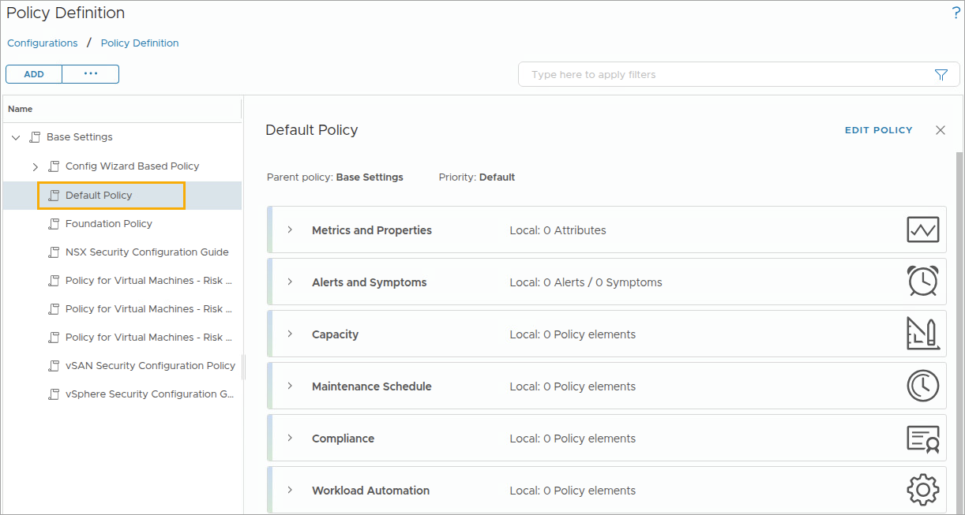
About the Default Policy
By default, the default policy is assigned to all vSphere objects. This policy is automatically created when you configure the VCF adapter for the first time.
Notes:
TalkTrack:
By default, the default policy is assigned to all vSphere objects. This policy is automatically created when the VCF adapter is configured for the first time. The policies library displays the base settings, default policy, and other best practice policies included with VCF Operations. The policies library contains all configurable settings for policy elements. These elements include workload, time remaining, and capacity remaining, among others.
<End>

Slide 10
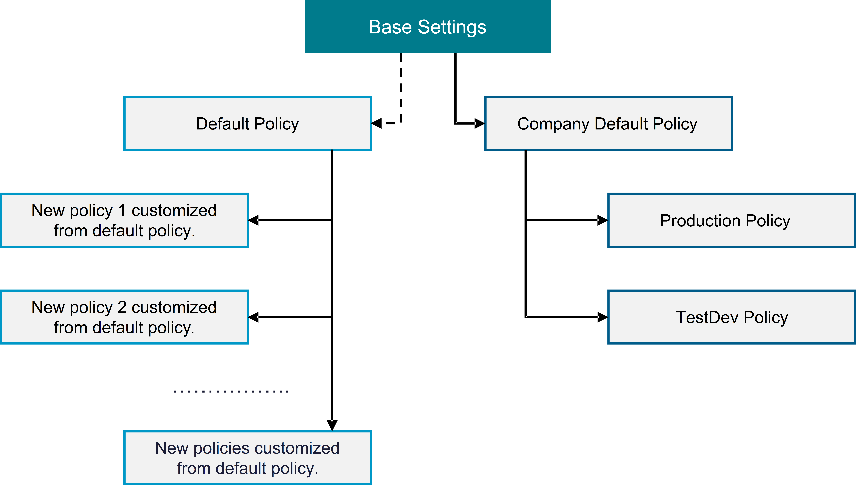
Policy Example
You must verify that your private cloud environment confirms to your company’s policies. You create a default policy for your company. You must also create separate policies for the production, test, and development environments.
Notes:
TalkTrack:
Ensuring a private cloud environment aligns with company policies is essential. A default policy is created for a company. Separate policies are also established for production, test, and development environments. The dashed arrow indicates the default policy, which is automatically generated after configuring the VCF adapter. The VCF adapter serves as the initial solution or data source endpoint for gathering environment data in VCF Operations. In the provided example, the company default policy inherits from the base settings. This company default policy is then customized to conform to specific company policies. A production policy is created for the production environment, and a TestDev policy is established for test and development environments. Both policies use the company default policy as their starting point.
<End>
The dashed arrow indicates the default policy, automatically created after configuring the VCF adapter (which is the first solution/data source/end point to be configured in VCF Operations for gathering environment data).
In the example, the company default policy is inherited from the base settings. Then you customize the company default policy to conform to your company’s policies.
You create a production policy for your production environment and the TestDev policy for your test and development environments. Both policies use the company default policy as the starting point.

Slide 11
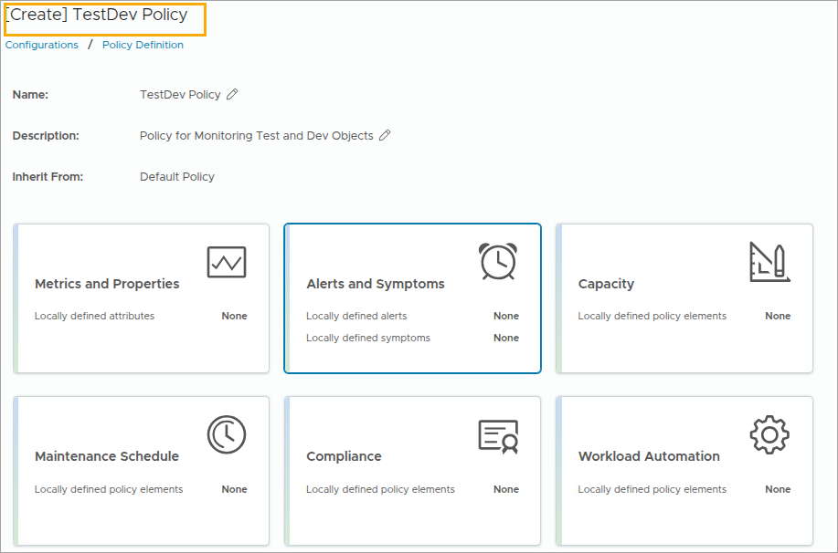
Policy Workspace: Creating Policy
You select a base policy from which your new custom policy can inherit settings.
Notes:
TalkTrack:
A base policy can be selected from which a new custom policy can inherit settings. The "Start with" drop down allows choosing a policy for a starting point. All settings from the chosen starting point are adopted as default settings in the new policy. The Policy Preview pane displays details for the selected policy configuration and the policy’s configuration. The number of enabled and disabled alert definitions, symptom definitions, attributes (devices and properties), and local changes are visible. A local change overrides the same setting in the parent policy. The default policy applies to most objects in an environment. A specific policy can be created for each object group. This facilitates easy monitoring and analysis of the dedicated group of objects.
<End>
You select a base policy from which your new custom policy can inherit settings:
The Start with drop-down menu allows you to select a policy for the starting point. All settings from the starting point policy are inherited as default settings in your new policy.
The Policy Preview pane displays tabs for the inherited policy configuration and the configuration of the policy that you create. You can view the number of enabled and disabled alert definitions, symptom definitions, attributes (metrics and properties), and local changes. A local change is a change made to a setting in the policy that you build. The change overrides the same setting in the parent policy.
You apply the default policy to most objects in your environment.
You create a separate policy for each object group. You make only minor changes in the settings for that policy. VCF Operations can monitor and analyze the dedicated groups of objects.
In the example, the TestDev Policy is created using vSphere Solution's Default Policy as the starting point.

Slide 12
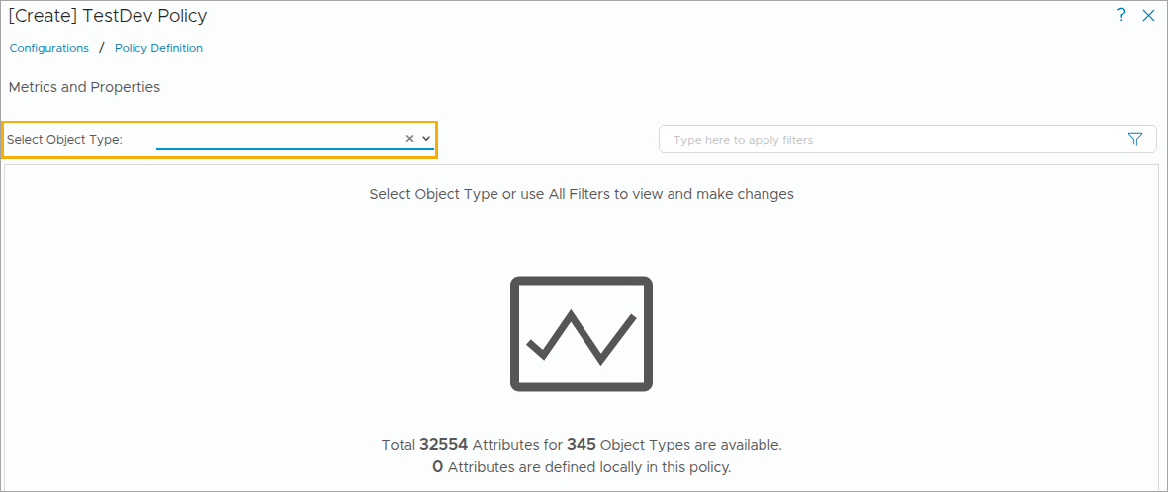
Policy Workspace: Metrics and Properties
You can select properties or metrics to include in your policy so that VCF Operations can collect data from the objects in your Private Cloud environment.
Notes:
TalkTrack:
Select properties or metrics to include in a policy. This enables VCF Operations to collect data from objects within a Private Cloud environment. The collection of each metric can be enabled or disabled. Alternatively, the parent policy can be relied upon to determine whether each metric needs to be collected. Within a policy, the collection of attribute types, including metrics, properties, and super metrics, can be enabled or disabled. These attribute settings are driven by symptom definitions, specifically metric-based and property-based symptom definitions. Attribute settings influence the alerts generated and the results reported in dashboard scores. Key performance indicators (KPIs) can be enabled, disabled, and inherited. KPIs can be considered controls for service-level agreements. A KPI is a crucial attribute or metric VCF Operations considers when measuring performance. For instance, disk command latency can be identified as a KPI on a datastore cluster object.
<End>
You can enable or disable the collection of each metric or enable the parent policy to determine whether each metric must be collected.
In your policy, you can enable or disable the collection of attribute types, which include metrics, properties, and super metrics.
These attribute settings are used by symptom definitions, specifically the metric-based and property-based symptom definitions. The attribute settings affect the alerts that are generated and the results that are reported in dashboard scores. Therefore, you must be aware of which symptoms use the metrics and properties that you customize.
You can enable, disable, and inherit key performance indicators (KPIs). You can consider KPIs as controls for the service-level agreements.
A KPI is an important attribute or metric that VCF Operations considers when measuring performance. For example, you might identify the disk command latency to be a KPI on a datastore cluster object.

Slide 13
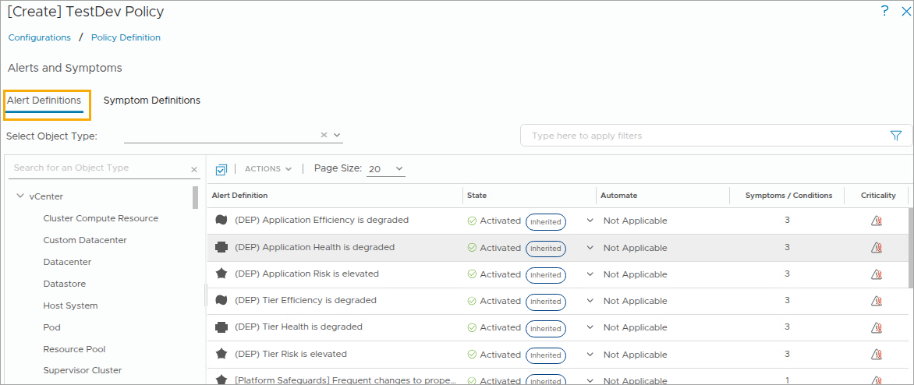
Policy Workspace: Alerts and Symptoms
You can override alert definitions by enabling or disabling them. Enabling alert definitions activates alerting conditions.
Notes:
TalkTrack:
Alert definitions can be overridden by enabling or disabling them. Enabling alert definitions activates alerting conditions. Each policy includes a package of alert definitions. Each alert utilizes a combination of symptoms and recommendations to identify a condition classified as a problem, such as failures or high stress. Alert definitions can be enabled or disabled within a policy. A local policy can be configured to inherit alert definitions from base policies. Alternatively, alert definitions and symptom definitions can be overridden for a local policy.
<End>
Each policy includes a package of alert definitions. Each alert uses a combination of symptoms and recommendations to identify a condition that is classified as a problem. For example, failures or high stress. You can enable or disable the alert definitions in your policy.
You can configure your local policy to inherit alert definitions from the base policies that you select or you can override the alert definitions and symptom definitions for your local policy.

Slide 14
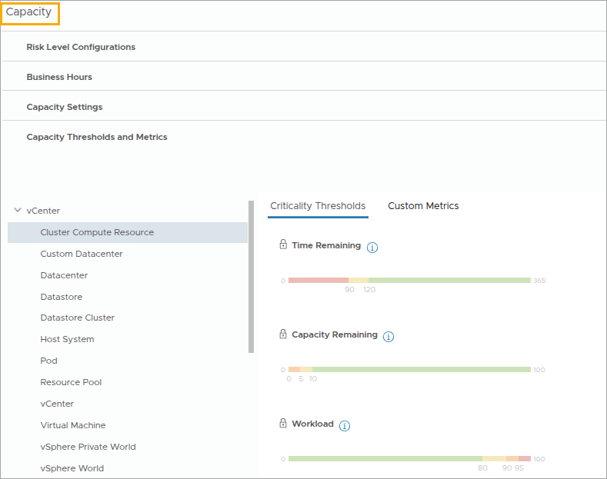
Policy Workspace: Capacity Settings
You can configure Time Remaining Calculations, Business Hours, Capacity Settings, and Criticality Thresholds in the Capacity section of the policy.
Notes:
TalkTrack:
Capacity settings can be configured to include remaining time calculations, business hours, capacity thresholds, and criticality thresholds within the policy section. The capacity remaining threshold setting is used to calculate the available capacity remaining before resources become unavailable. There are various options available for calculating the time remaining. Conservative time remaining projects the upper bound closest to usable capacity thresholds, based on an upper-bound projection. Aggressive time remaining represents the time remaining before projected mean crosses the usable capacity threshold, based on the mean projection. Time remaining indicates the time until the object group uses all its resources. VCF Operations calculates the time remaining as the number of days remaining until all capacity is used minus the number of days allocated to the provisioning buffer. The time remaining threshold setting can be used to calculate the amount of time remaining before resources become unavailable. The default threshold setting can be overridden to meet specific needs of an environment. Capacity remaining indicates the capability of an environment to accommodate new machines. VCF Operations calculates the capacity remaining as a percentage of the overall capacity that remains for the number of virtual machines compared to the total number of virtual machines that is deployed on the selected object. The capacity remaining threshold setting can be used to calculate available capacity remaining before resources are unavailable. The default threshold setting can be overridden to meet specific needs of an environment. Workload specifies the measurement of demand for resources on an object. The workload threshold setting allows for configuring the CPU and memory metrics, such as usage and demand. Workload is the immediate percentage of capacity used by the most constrained in the several key resource counters. Because the workload changes in every collection cycle, a specific number of cycles can be set to trigger a clear alert.
<End>
You use the Capacity Remaining threshold settings to calculate the remaining available capacity before resources are unavailable.
The following options are available in the policy setting to calculate the remaining time:
Conservative time remaining: Represents the time remaining before the projected upper bound crosses the usable capacity threshold. It is based on the upper-bound projection.
Aggressive time remaining: Represents the time remaining before the projected mean crosses the usable capacity threshold. It is based on the mean projection.
Time Remaining: Indicates the time that is remaining before the object group uses all the resources. VCF Operations calculates the time remaining as the number of days remaining until all the capacity is used minus the number of days allocated to the provisioning buffer.
You use the Time Remaining threshold settings to calculate the amount of time remaining before resources are unavailable. You can override the default threshold settings to meet the specific needs of your environment.
Capacity Remaining: Indicates the capability of your environment to accommodate new machines. VCF Operations calculates the capacity remaining as a percentage of the overall capacity that remains for the number of virtual machines compared to the total number of virtual machines that is deployed on the selected object.
You use the Capacity Remaining threshold settings to calculate the available capacity remaining before resources are unavailable. You can override the default threshold settings to meet the specific needs of your environment.
Workload: Specifies the measurement of the demand for resources on an object. You use the Workload threshold settings to calculate the CPU and memory metrics such as usage and demand. Workload is the immediate percentage of capacity used by the most constrained in the several key resource containers. Because the workload changes in every collection cycle, you can set the number of cycles required to trigger or clear an alert.

Slide 15
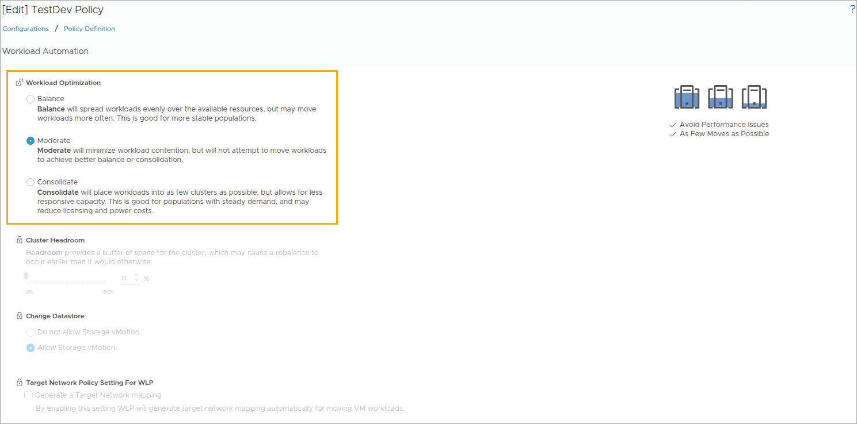
Policy Workspace: Workload Automation Details
You can set the workload automation options for your policy, so that VCF Operations can optimize the workload in your environment as per your definition.
Notes:
TalkTrack:
Workload automation options can be configured for a policy, allowing VCF Operations to optimize an environment. Clicking the lock icon enables unlocking and configuring workload automation specifics for a policy. When the lock icon is clicked, the policy inherits its parent policy settings. Available options for policy settings in workload automation include selecting a goal for workload optimization. Goals include balancing workload performance, which proactively moves workloads so that resource utilization is balanced, leading to maximum headroom for all resources. Another goal is minimizing workload contention. A third goal involves consolidating proactively the minimum number of clusters used by workloads. This approach is beneficial for cost optimization, while ensuring performance goals are met, and may also reduce licensing and power costs. Cluster headroom establishes a required capacity buffer, for example, 20 percent. This provides an extra level of control and ensures sufficient space for growth within the cluster. Defining a large headroom setting limits optimization opportunities. vSphere HA overhead is already included in usable capacity and does not impact HA overhead. Storage datastores can be modified by clicking the lock icon to select one of the following options. Disabling storage vMotion is an option. Enabling storage vMotion is selected by default. When using this option, specific types of virtual machines can be selected to move to address the workload. Target network policy settings for Workload Placement (WLP) can be selected by clicking the lock icon. Generating a target network when the checkbox is selected automatically chooses a competitive target network. This decision is made by the optimization for choosing a compatible network. WLP engine considers the segment path and logical switch Distributed Port Group. Workload optimization across networks is supported when the optimization candidate clusters are assigned different port groups configured with NSX. These port groups configured via NSX have the same segments and logical switch IDs. This capability is enabled by checking the respective setting in workload automation policy settings.
<End>
You click the lock icon to unlock and configure the workload automation options specific for your policy. When you click the lock icon to lock the option, your policy inherits the parent policy settings.
The following options are available in the policy setting for workload automation:
Workload Optimization: Select a goal for workload optimization.
Select Balance when workload performance is your first goal. This approach proactively moves workloads so that the resource utilization is balanced, leading to maximum headroom for all resources.
Select Moderate when you want to minimize the workload contention.
Select Consolidate to proactively minimize the number of clusters used by workloads. You might be able to repurpose resources that are freed up. This approach is good for cost optimization, while making sure that performance goals are met. This approach might reduce licensing and power costs.
Cluster Headroom: Headroom establishes a required capacity buffer, for example, 20 percent. It provides you with an extra level of control and ensures that you have extra space for growth inside the cluster when required. Defining a large headroom setting limits the systems opportunities for optimization.
vSphere HA overhead is already included in useable capacity and this setting does not impact the HA overhead.
Change Datastore: Click the lock icon to select one of the following options:
Do not allow Storage vMotion.
Allow Storage vMotion. This is selected by default.
Using this option, you can select what type of virtual machines VCF Operations moves first to address the workload.
Target Network Policy Setting for WLP: Click the lock icon to select the following option:
Generate a Target Network mapping: When you select this checkbox, the Workload Placement algorithm in will automatically choose compatible target network, while making the decision to move the VM for the optimization. For choosing compatible network WLP engine will consider the segment path and logical switch UUID of the Distributed Port Group.
Workload Optimization Across networks is supported when the optimization candidate clusters are assigned with different port groups (configured with NSX). These port groups configured via NSX have same segmentID and Logical Switch UUID. To enable this ability, check the respective setting in Workload Automation policy settings.

Slide 16
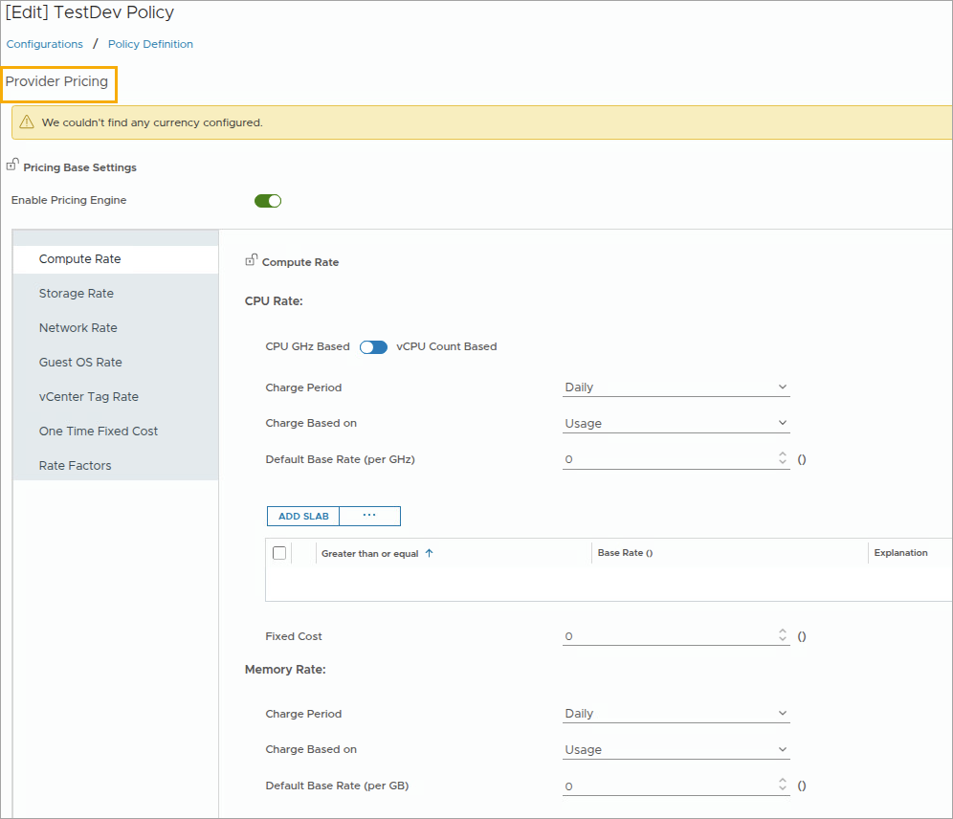
Policy Workspace: Configuring Provider Pricing
You can add and assign new pricing cards to vCenter and clusters in VCF Operations. The pricing card can be cost-based or rate-based. You can customize the cost-based pricing card and rate-based pricing card as per your requirement.
Notes:
TalkTrack:
New pricing cards can be added and assigned to vCenter and Clusters within VCF Operations. The pricing card can be cost-based or rate-based. Cost-based pricing and rate-based pricing can be customized as per requirements.
<End>
For information on the Provider pricing, please refer to the documentation at https://techdocs.broadcom.com/us/en/vmware-cis/vcf/vcf-9-0-and-later/9-0/cost-and-capacity-management/performing-vcd-based-multitenancy-operations/configuring-vcd-pricing-details.html

Slide 17
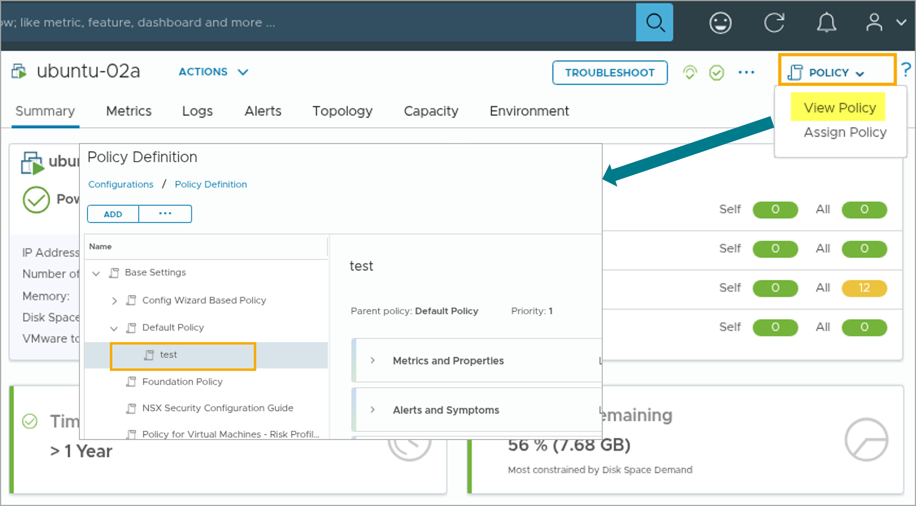
Viewing the Effective Policy
In the Policy drop-down menu, the View Policy option appears in the content pane of the selected object.
Notes:
TalkTrack:
From the Policy drop-down menu, the View Policy option appears in the content pane of the selected object. VCF Operations utilizes the effective policy to analyze objects. It controls the data collected from the objects. The effective policy also generates alerts when problems occur. Finally, it displays results in the dashboards. In the example, ubuntu-02a is the selected object. Its effective policy is the test policy.
<End>
VCF Operations uses the effective policy to:
Analyze objects.
Control the data that is collected from the objects.
Generate alerts when problems occur.
Display the results in the dashboards.
In the example, ubuntu-02a is the selected object. Its effective policy is the test policy.

Slide 18
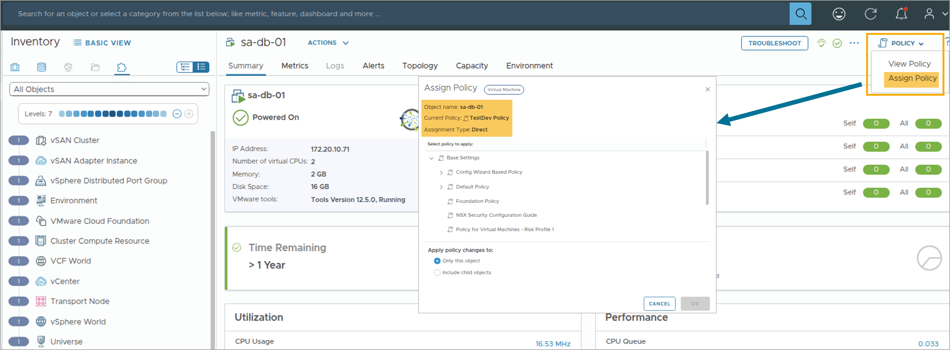
Assigning a Policy for a Single Object
In the Policy drop-down menu, the Assign Policy option appears in the content pane of the selected object.
Notes:
TalkTrack:
From the Policy drop-down menu, the Assign Policy option appears in the content pane of the selected object.
<End>

Slide 19
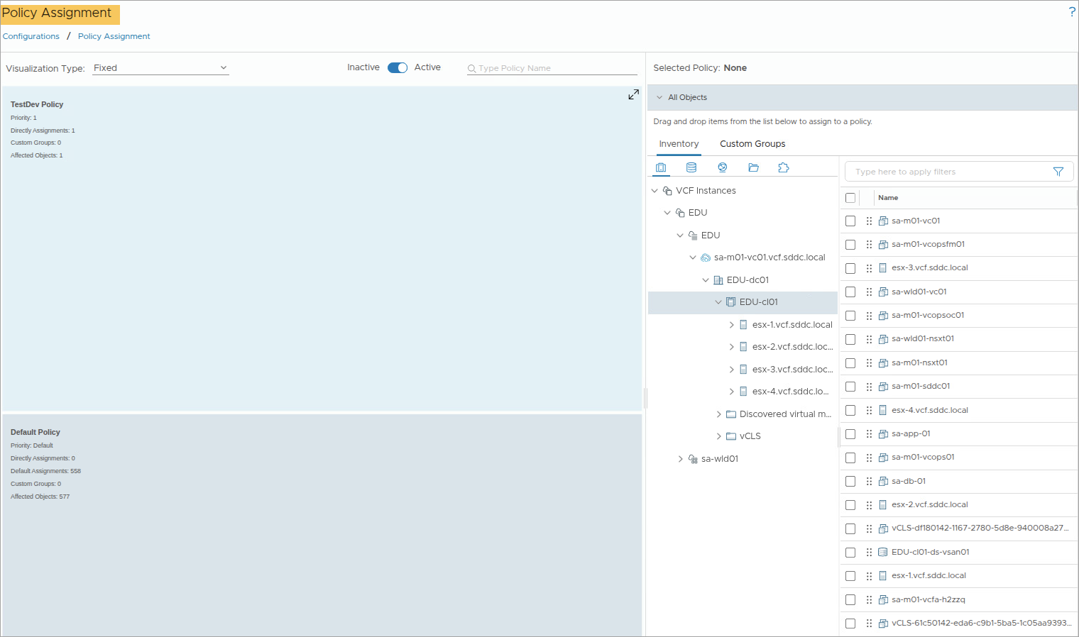
Assigning Policies
You can assign policies to your environment to activate controls and view and manage your object assignment scope.
Notes:
TalkTrack:
Policies can be assigned to an environment to activate controls, view, and manage object assignments. The policy assignment workspace offers several options. The left pane displays a list of available policies and provides filters to understand policy distribution. Policies can be filtered by inactive or active status. A policy is considered active only when assigned to an object or a custom group. A toggle switch helps filter between inactive and active policies. Visualization Type allows sorting active policies based on different criteria. Sorting options are only available for active policies. "Fixed" displays active policies with sections of fixed and equal numbers of policies. "By Assignments" displays policies based on the number of objects assigned. "Affected Objects" displays policies based on the affected object count. The policy name can be typed in the search box to filter by policy name.
<End>
Policy assignment workspace has the following options:
Left Pane: Displays the list of policies available in your environment and provides different filters to understand policy distribution.
Inactive/Active: You can filter policies by active or inactive status. A policy is considered to be active only when it is assigned to an object or a custom group.
You use the toggle switch to filter between Inactive and Active policies.
Visualization Type - You can sort active policies based on different criteria. The sorting options are available only for the active policies.
Fixed: Displays active policies with the sections of the policies fixed and equal to each other.
By Assignments: Displays the policies based on the number of objects assigned.
By Affected Objects: Displays policies based on the affected object count.
Type Policy Name: Type the name of the policy in the search box to filter by policy name.

Slide 20
Policy Inheritance
You can determine how a policy applies to an object:
Identify the group or groups of which the object is a member.
Identify policies that are assigned to these groups.
Determine the policy that has the highest priority.
The policy with the highest priority is the effective policy for that object.
Notes:
TalkTrack:
It is possible to determine how a policy applies to an object. First, identify the group or groups to which the object belongs. Then, identify the policies assigned to those groups. Finally, determine the policy with the highest priority. The policy with the highest priority is the effective policy for that object. Understanding policy inheritance helps place policies correctly in the hierarchy. Changes to a policy might affect other policies depending on their position in the hierarchy. An object must belong to a group. A policy is applied to that group. If an object belongs to multiple groups, and each group has a different policy assigned, the policy priority determines the effective policy for the object.
<End>
Understanding how the policy inheritance works enables you to place your policies in the policy hierarchy properly. If you change a policy, other policies might be affected depending on their location in the hierarchy.
An object must belong to a group. Then, a policy must be applied to that group. If an object belongs to more than one group and each group is assigned a different policy, the policy priority determines the effective policy of the object.

Slide 21
Importing and Exporting Content
To reuse content between VCF Operations deployments or back up the custom content, use the export and import functions.
You can export and import the following content:
Policies
Dashboards
Views
Reports
Alert definitions
Symptom definitions
Recommendations
Super metrics
Notes:
TalkTrack:
To reuse content between VCF Operations deployments or to back up custom content, use the export and import functions. Content that can be exported and imported includes policies, dashboards, views, reports, alert definitions, symptom definitions, recommendations, and super metrics. Importing and exporting allows sharing content between VCF Operations instances. For example, content can be created for a test and development environment. After validating the content, it can be exported and then imported into a production environment. This avoids recreating the content. By importing content such as an alert definition, VCF Operations can assume the same alert monitoring setup as an earlier deployment.
<End>
Importing and exporting allows you to share content between VCF Operations instances. For example, you might create content for a VCF Operations instance in your test and development environment. After you create and validate the content, you might want to use the same content for a VCF Operations instance in your production environment. Instead of recreating the content, you can export content from your test and development environment and import the content to your production environment.
By importing content such as alert definition, VCF Operations can assume the same alert monitoring that was done by an earlier deployment.

Slide 22
Lab: Creating Custom Policies
Create custom policies for TestDev Group and VMScale Group:
Create the TestDev Custom Group
Create the VMScale Custom Group
Create the TestDev Policy for Objects in the TestDev Group
Create the VMScale Policy for Objects in the VMScale Group
Review Policy Assignments
Export a Policy

Slide 23
Review of Learner Objectives
Use policies to analyze information about various object types and objects in your environment
Configure policies and other components
Perform the importing and exporting of content

